Slide 1
PHY377/477 Soft Condensed Matter
Dr Martin Grell
Slides developed from Prof Mark Geoghegan’s prior material
Based on R A L Jones “Soft Condensed Matter” (OUP, Oxford, 2002)

Slide 2
Lecture #0 Soft Matter course content
0. Welcome / Introduction
1. Introduction, molecular forces, bulk mechanics
2. Polymers
3. Miscibility(混溶) and Separation
4. Crystallinity（结晶度） in soft matter
5. Chirality（手性） and Liquid Crystallinity（液晶性）
6. Interfaces and Self-assembly（自组装）

Slide 3
PHY377/477 ‘Soft Condensed Matter’
0. Welcome and general information – Autumn semester 2017/18
Module leader: Dr Martin Grell, m.grell@sheffield.ac.uk, Hicks D30
‘Parallel’ modules: PHY377 / PHY477
Same lectures and exam for 3rd/4th Yr, small difference in other assessment
Lectures: Tue 11am, Thu 9am, for both 377/477
→ Sign In!
Supported by MOLE

Slide 4
Assessment:
PHY377: 80% exam, 20% assessed Homework
PHY477: 65% exam, 20% assessed Homework, 15% Essay
Pass mark: 40% for 377, 50% for 477
Homework: Released Mon 29 Oct on MOLE
Deadline Mon 26 Nov
Submission to Hicks drop box with bar- coded cover sheet
Essay: 477 only Essay topics and detailed instructions
on MOLE now. Submission to Turnitin embedded
into MOLE. Deadline Mon 12 Nov
Exam: More nearer the time
Recommended reading:
Slides, Lecture Notes, and parallel problems on MOLE
RAL Jones, ‘Soft Condensed Matter’, OUP
on Polymers: Polymers: Chemistry and Physics of Modern Materials,
Third Edition J.M.G. Cowie, Valeria Arrighi

Slide 5
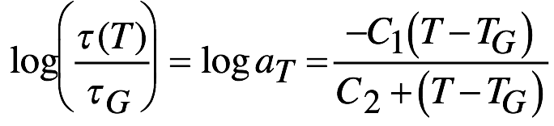
3rd Yr vs. 2nd Yr: No more problems classes / tutorials
!? So how to study / practice / revise?
➔ Lectures! (not just the first few), incl. Problems Sessions
➔ Homework = Mini Exam
➔ Make time for guided self- study
10 credit module: ~ 100 hrs of work vs. 22 lecture slots
➔ Revision lectures in January
➔ ‘Parallel Problems’ section on MOLE:
Numbered problems in parallel to lecture, e.g.
…
C₁, C₂ near- universal: C₁ = 17.4 and C₂ = 51.6 K = T_{G} – T_{VF}
a_{T} : Williams- Landel- Ferry (WLF) scaling factor
aka ‘time- temperature superposition’ P4.2
…

Slide 6
Objectives
Appreciate alternatives to conventional solid state physics
‘Molecular materials’, in particular polymers
See physics beyond the periodic crystal
e.g. glasses, ‘scaling laws’, liquid crystals, micelles,..
Meet molecular engineering materials, and devices
e.g. polymers, rubbers, liquid crystal displays
See synergies of Physics with other sciences
e.g. physical chemistry, life sciences
Understand ‘self assembly’ of molecular materials

Slide 7
Lecture #1 Soft matter aka ‘molecular materials’
Pt. 1 Introduction, molecular forces, bulk mechanics
What do we mean by ‘soft matter’? ‘Hard’ vs ‘Soft’
‘Molecular materials’

Slide 8
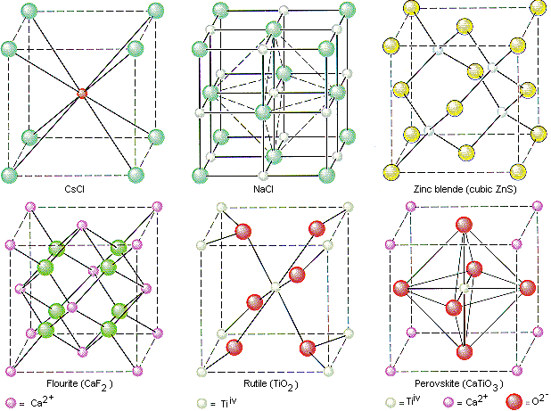
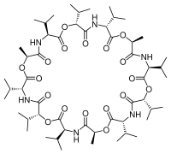
‘hard’ vs. ‘soft’ matter
Solid state physics: The unit cell is the basic unit
→ Periodic crystal, wave- like excitations, E(k)
Often, high melting temperature
But: when dissolved (e.g. water, acid):
Unit cell falls apart. Same chemical elements, but very different properties.
Soft matter: The molecule is the basic unit
→ ! Also may form crystals (‘molecular crystals’)
But molecular properties dominate
Localised excitations
Dissolves (e.g. water, organic solvent): Molecules are retained / stay together
Many properties are retained.
Key player: Solvents (incl. water)

Slide 9
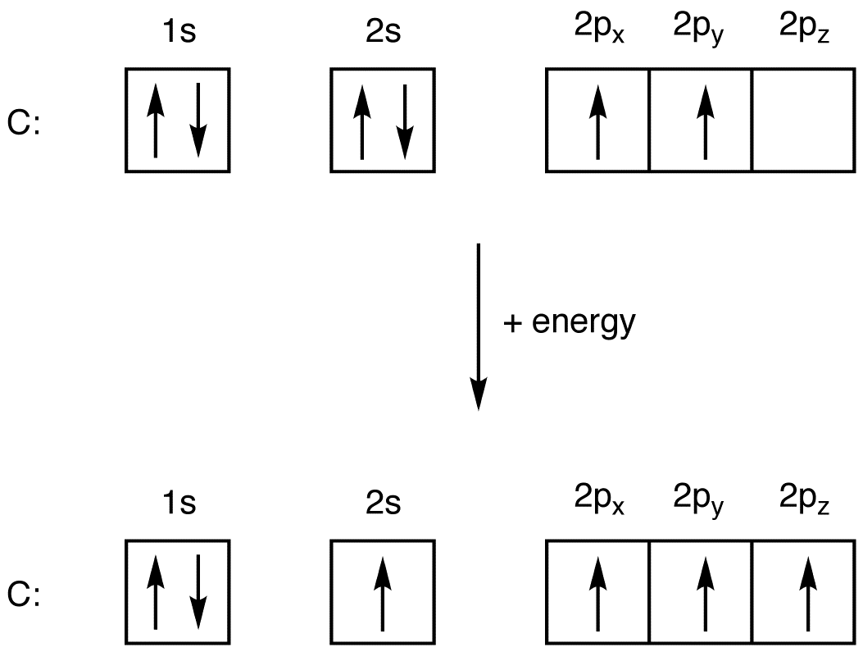
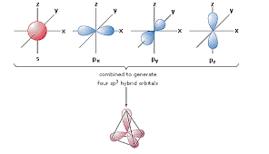
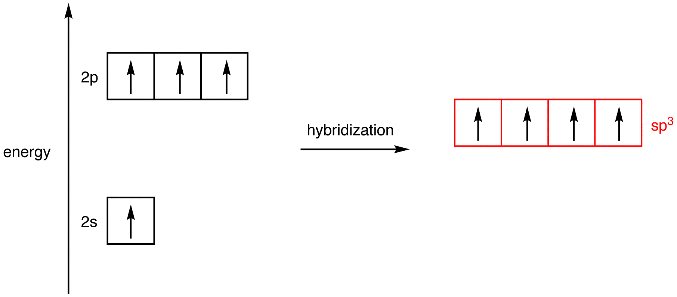
Molecular materials: Carbon ’organic’ molecules: Contains at least one C-H bond
C orbitals: 6 e⁻
1 x 2s + 3 x 2p:
‘Promotion’
4 x sp³ hybrids:
4 x 1 e⁻ orbitals
Want 2nd e⁻…
Hybridisation:
4 x sp³ hybrid
‘Tetraeder’ P1.1
Angle btwn bonds = 109.5º
‘Hybridization（杂化）’
4 bonds from sp³ hybrids: ‘Saturated’ C (single bonds only)
Also: sp², sp hybrids → ‘unsaturated’ C (double/triple bonds)
Different geometry→ molecular shape
J H van ‘t Hoff
Nobel Prize 1901

Slide 10
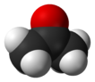
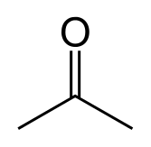
Molecular materials Illustrating（说明） organic molecules and their shapes
e.g. (linear) Hexane（己烷）: 6 saturated（饱和的） (sp³ carbons) + ‘enough’ H
Highly stylised
C and H implied
Note ’zig zag’
from sp³ angle
Acetone（丙酮）: Only ‘heteroatom’ shown
Here, oxygen (O)
Note, double bond: unsaturated middle C
=
Butene（丁烯）:
C=C double bond
Unsaturated (sp² hybrid)
Butyne（丁炔）:
Triple bond (sp hybrid)
≠
Trans-2- butene vs. cis-2-butene: ‘Isomerism’（异构）

Slide 11
Molecular materials Examples of organic molecules: Rings
Benzene（苯）
Cyclohexane（环己）
6 sp² hybridised C in a (planar) ring:
3 Alternate 3 double / 3 single bonds- but where?
Unhybridised p electrons delocalise around ring
‘conjugation’, π electrons
6 sp³ hybridised C in a ring:
saturated, no conjugation
Not planar
Heterocycles（杂环）: Rings with ‘hetero’ atoms (other than C)
Thiophene Furane Pyrrole

Slide 12
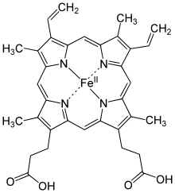
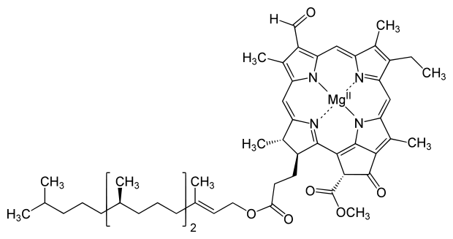
Molecular materials Big rings: Macrocycles
Heme B
Crown ether
18-crown-6
Valinomycin
Charles J Pedersen
Nobel Prize 1987
Chlorophyll
Soft matter device technology:
Photosynthesis, oxygen transport,
ion selection

Slide 13
Molecular materials Amino acids
(carboxylic)
acid
Amine
Amine + carboxylic acid
→ Peptide bond

Slide 14
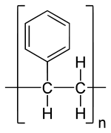
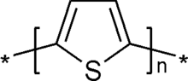
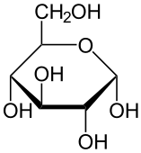
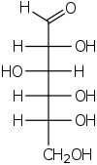
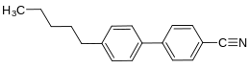
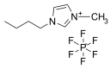
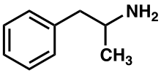
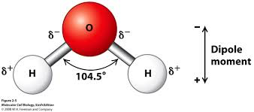
Molecular materials Some more organic molecules…
←→
Polystyrene
Polythiophene
Glucose
An ionic liquid
(molten organic salt)
5-Cyanobiphenyl
P1.2
+ one all- important
inorganic molecule…
An illegal amine

Slide 15
Summary Lecture #1 Soft matter aka ‘molecular materials’
Soft Matter Physics: Physics of molecular materials. Molecules rule over unit cells
Strong chemical bonds within molecules, weaker forces btwn molecules
Mostly: Organic molecules built from hybridised C orbitals + H,O,N,S,P, and ‘water’
A rich ‘zoo’ of molecules
Molecular ‘device technology’, often in wet medium ←→ Life

Slide 16
Lecture #2 Gases, Liquids, Solids
States of Matter
Forces / energies within / between molecules
Phase diagram, coexistence

Slide 17
Gases, liquids, and solids
A reminder...
Internal energy of gases is largely kinetic: rotational, vibrational, and translational
The kinetic energy of molecules or atoms in solids is not enough to overcome their energy of interaction
Energy of interaction between liquid molecules is comparable to their kinetic energy

Slide 18
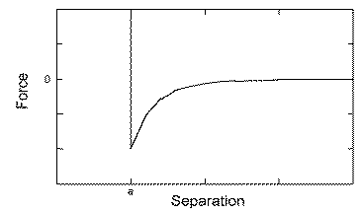
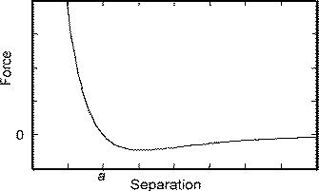
Potential energy-separation curves
Hard sphere model
Real systems
Force: Strong repulsion at short distance
Weak attraction at large distance, fading to zero for d → infinity
Energy: Minimum -ε_{Β} at equilibrium distance, a: ‘Bond energy/length’
Applies to both bonds w/in molecules, and interactions btwn molecules
Btwn molecules: ε_{Β} related to ΔH_{vap} or ‘cohesive energy density（内聚能密度）’

Slide 19
Bonding vs. attractive interactions
Bonds within molecule / crystal
Ionic bonding (Salts)
Transfer of electrons
Strong, ~ 6 eV (e.g NaCl,
weaker in ‘ionic liquids’)
Covalent bonding: Molecules
Shared electrons / overlapping orbitals
Strong and directional, (2 ...6) eV
e.g. sp³ hybridised C-H in organic molecules
Metallic bonding
Delocalized electrons
Strong, similar to covalent but undirected. E.g. transition metals, also alloys
Attraction between molecules
van der Waals force
Incl. dipolar interactions
U ~ α²r⁻⁶ typically ~ 60 meV, comparable to thermal energy ~ 25 meV
Hydrogen bonding
Hydrogen (H bond donor) interacts with electronegative atoms (H bond acceptor)
Directional strong(ish), 120…370 meV
Hydrophobic interaction
Entropic interaction in water ~ 60 meV P2.1
1 eV = 96.5 kJ/mol

Slide 20
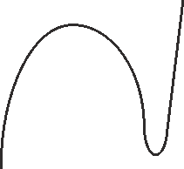

The three (common) states of matter
Gas
Liquid
Solid
Pressure
Temperature
Liq.
Solid
Gas
Temperature
Density
Triple point
Critical point
Coexistence
Crossed area: No single phase
Coexistence
Coexistence occurs even in a pure material
Coexistence is very common in mixtures
(Liquid/solid, 2 liquid phases, …)

Slide 21
Blends Coexistence of phases is common
Water / Ethylene Glycol: ‘Antifreeze’（防冻液） (simplified)
‘Binary phase diagram’
Note the axis:
T vs. composition, no p
Blue, yellow::Coexistence
btwn liquid and solid
Melting/freezing, latent heat,
spread over T range
‘Eutectic（共晶）’: T_{E} below either melting point due to entropy of mixing
Blend remains liquid to much lower T than either pure material

Slide 22
Summary: Lecture #2 Gases, Liquids, Solids
3 common states of matter (more to come)
Strong chemical bonds hold molecules together, weaker intermolecular forces make molecules condense
Condensed phases: Solid or liquid
Different phases may coexist even for pure substances
Coexisting phases common in mixtures/blends
Blending favours liquid phase, extending to lower T
‘Eutectic’
Some material contained within this lecture can be found in SCM chapter 2 up to 2.2

Slide 23
Lecture #3 Mechanical properties of soft matter
Linear mechanical behaviour: Solid vs. liquid
Shear thickening / thinning（剪切增稠/变稀）
Viscoelastic behaviour（粘弹性）
Simple vs complex fluids
Relaxation time and cooperativity（协同）

Slide 24
Linear mechanical behaviour I
Hookean (elastic) solid
Shear stress in response to shear strain (or vice versa)
Shear stress, σ = F/A
Shear strain, e or ε = Δl/z = tanθ ≈ θ
Constant of proportionality is the shear modulus G
G = σ/ε ⬅➔ σ = Gε
Δl
A
F
z
θ
! Shear strain / modulus (G) vs. tensile strain / modulus (E)
Macroscopic E can be equated to bond energy density, ε_{B}/a³ P 3.1

Slide 25
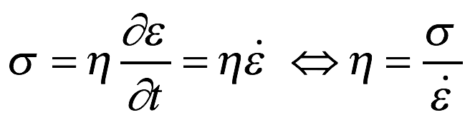
Linear mechanical behaviour II
Newtonian liquid
Flow gradient in response to shear strain
Stress, σ = F/A (again)
Flow gradient (strain rate)
Constant of proportionality is the viscosity η
Given by
A
F, v
y
θ

Slide 26
Shear thinning and thickening
∂ε/∂t
∂ε/∂t
∂ε/∂t
σ
σ
σ
η
η
η
∂ε/∂t
∂ε/∂t
∂ε/∂t
Newtonian fluid
Shear thinning
Shear thickening
Notes:
Shear thickening is a dilatant – silly putty is an example.
Shear thinning is exemplified by paints and ketchup. Avoid using thixotropic. It is not strictly correct.

Slide 27
Viscoelastic behaviour
Not all materials behave as Newtonian liquids or Hookean solids
Many materials exhibit a time-dependent response to stress
This is known as viscoelastic behaviour
Initial response is elastic
Long time response is viscous
Examples of viscoelastic materials include:
Molten polymers（熔融聚合物）
Colloidal systems（胶体系统） (e.g. paint, wet cement, shampoos)

Slide 28
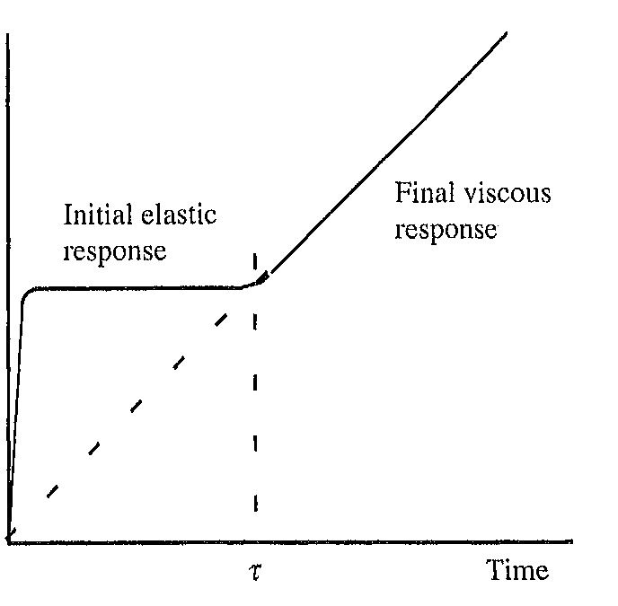
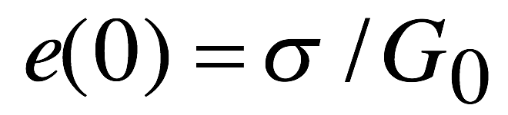
Relaxation time τ
Short time: Elastic, modulus G₀
Long time: Viscous flow（粘性流动）, viscosity η
Transition at characteristic τ
Relaxation time τ = η / G₀
Typically, τ = τ(T)
because η = η(T),
G₀ often not so much
Reality: Often much smoother
transition
Strain e
(RAL Jones, SCM, Fig. 2.5)
Rough guide: τ > 10 s: Solid, τ < 10s : Liquid

Slide 29
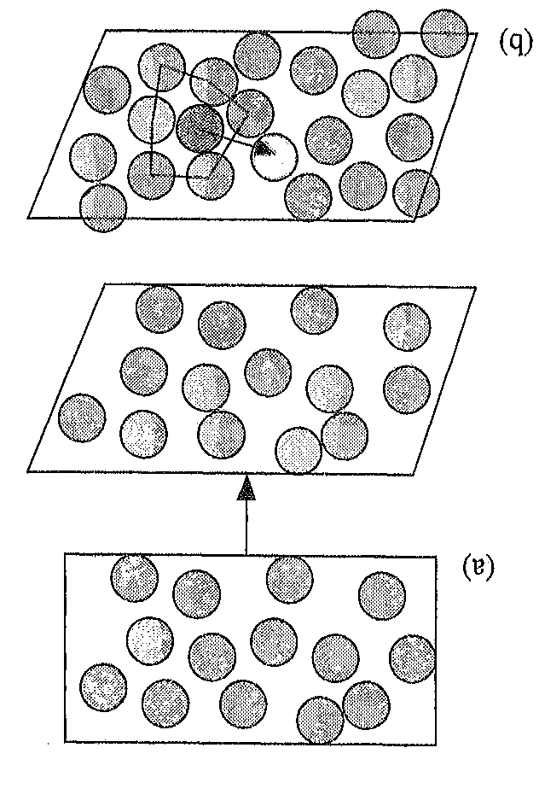
Viscous flow of simple fluids, e.g. water
Viscous, not elastic, due to short relaxation times
Assume a molecule is temporarily in a higher energy position due to shear.
Will ‘relax’ by jumping into nearby void
Relaxation time τ = τ_{p}exp(ε_{e}/k_{B}T) ‘Arrhenius’
(Note ‘Boltzmann factor’: Thermally activated overcoming of energy barrier)
Activation energy ε_{e} ≈ 0.4 ΔH
(τ_{p})⁻¹ ≈ optical phonon frequency of
corresponding solid (Eyring)
Typically, τ_{p} ≈ picoseconds（皮秒） ➔ Short τ
→ ∞ for T → 0 (but freezes long before)
Many liquids crystallise before τ > 10 s (but not all)
SCM Fig. 2.8

Slide 30
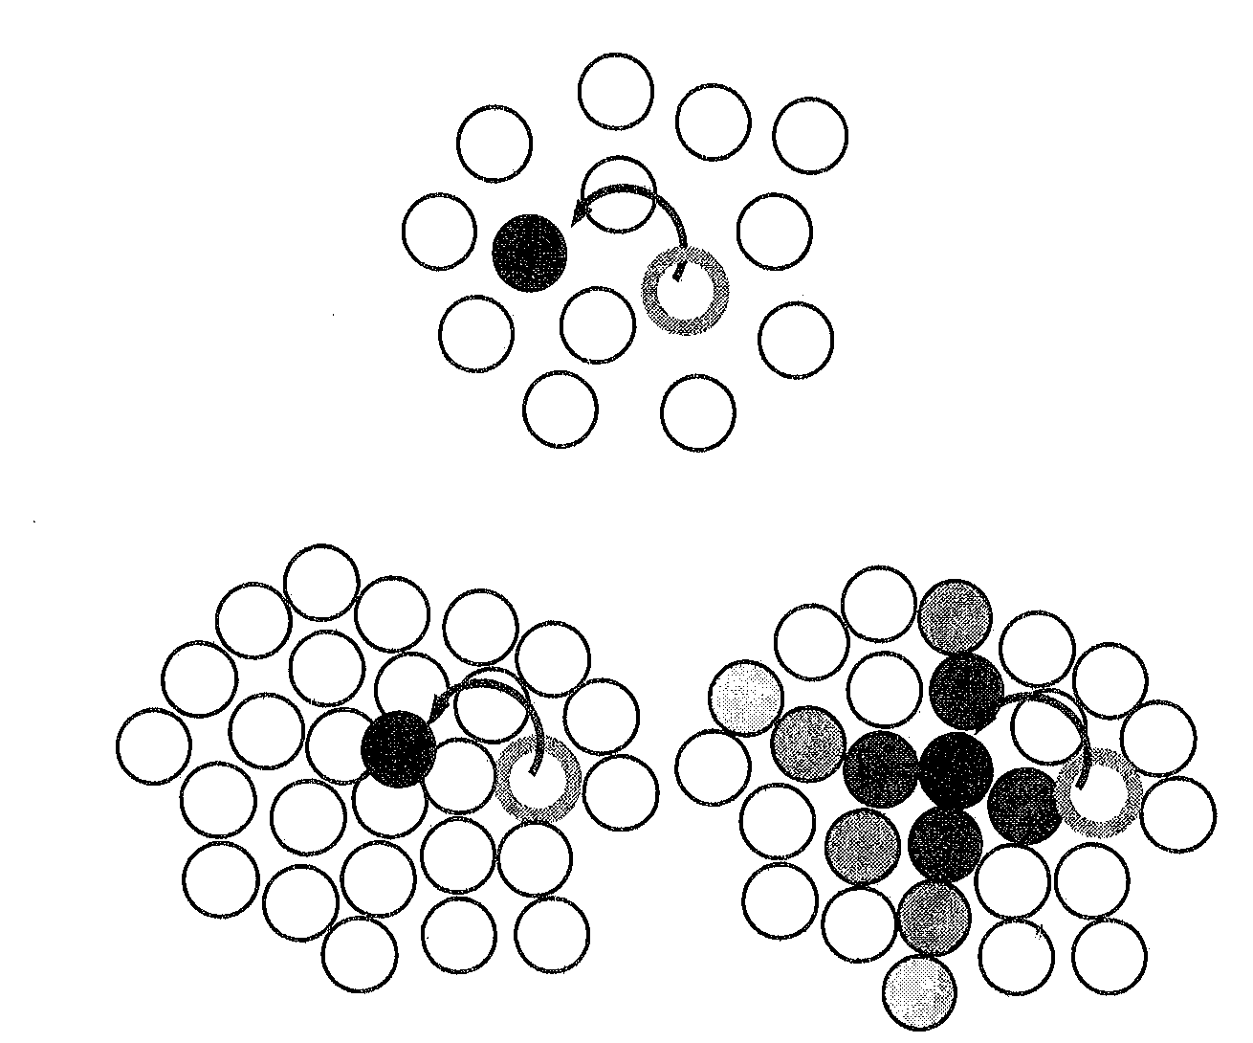
Flow of complex fluids: ‘Cooperativity’
Complex fluid: z > 1 molecules to make
way for one to move: ‘Cooperativity’
ε_{e} → zε_{e}, z increases as T drops
Arrhenius no longer applies
Steeper rise of τ with dropping T
Complex fluids reach τ = 10s
before crystallising
(←→ η ≈ 10¹³ Poise（平衡） with typical G₀)
Also: τ → ∞ at T > 0
SCM Fig 2.13
> 10s : Non- crystalline (‘amorphous’)（非晶） solid, aka ‘Glass’
T(τ = 10s): Glass temperature T_{G}
Glass: Mechanically solid, but structured like a liquid (no unit cell)

Slide 31
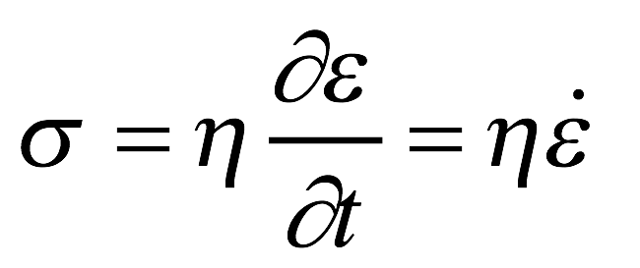
Summary: Lecture #3 Mechanical properties of soft matter
Simplistic ‘extremes’ of mechanical behaviour:
→ Hookean / Elastic: σ = Gε (solid)
→ Newtonian / viscous: (liquid)
Soft matter: Often nonlinear and ‘mixed’ properties
Shear thinning / shear thickening
‘Viscoelasticity’: Elastic up to τ / viscous at t > τ
Temperature- dependent ‘relaxation time’ τ(T) = η/G
Different τ(T) / η(T) for simple / complex fluids
Simple: Arrhenius, τ → ∞ for T → 0, Complex: ‘super’ Arrhenius (cooperativity), τ → ∞ for T > 0
τ > 10s w/out crystallisation: Glass transition
The material contained within this lecture can be found in SCM chapter 2.3

Slide 32
Lecture #4: The Glass transition
The glass transition: Flow seizing up
Mechanics:
‘strong’ vs. ‘fragile’ glasses
Vogel- Fulcher, Williams- Landel- Ferry
Thermodynamics
Glass transition vs. phase transition
Kauzmann paradox

Slide 33
Glasses are common
Polymers (most interesting here), also some solvents ( e.g. toluene)
Oxide glasses, e.g. (Si/Na/Ca) oxides (windows)
Chalcogenide glasses, e.g. GeS (low gap semiconductors)
Some Elements (S, P, Se)
Magnetic metals when rapidly cooled (‘spin glasses’)

Slide 34
Recap: ‘Cooperativity’ in complex fluids
Complex fluid: z > 1 molecules to make
way for one to move: ‘Cooperativity’
ε_{B} → zε_{B}, z increases as T drops
Arrhenius no longer applies
Steeper rise of τ with dropping T
Complex fluids reach τ = 10s
before crystallising
(←→ η ≈ 10¹³ Poise with typical G₀)
Also: τ → ∞ at T > 0
SCM Fig 2.13
> 10s : Non- crystalline (‘amorphous’) solid, aka ‘Glass’
T(τ = 10s): Glass temperature T_{G}
Glass: Mechanically solid, but structured like a liquid (no unit cell)

Slide 35
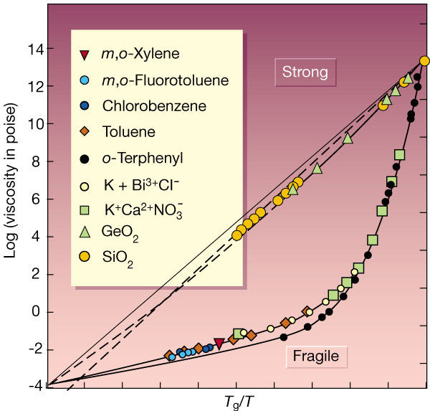
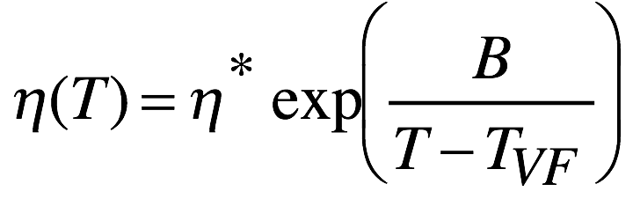
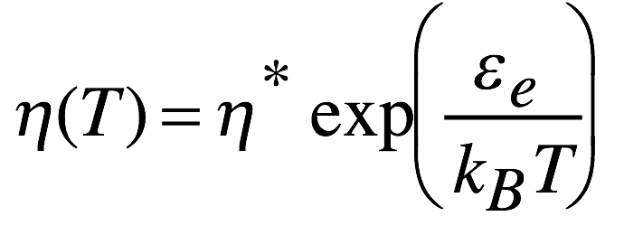
T_{g} Mechanics: η(T) at glass transition
‘Strong’ glasses:
Arrhenius behaviour η ∼ τ
η → ∞ for T → 0
All polymers, and many others:
‘fragile’ glasses:
Vogel- Fulcher (VF)
→ ∞ for T → T_{VF} > 0
T_{VF} ≈ T_{G} – 50K
No ‘glass blowing’ with fragile glasses

Slide 36
Polymer glasses: WLF
Fragile glass viscosity η vs. T scales with VF
Relaxation time τ ~ η, apply VF for τ(T), referenced to τ_{G} P4.1
τ(T) / τ_{G} :
Relaxation times at T / at T_{G}
C₁, C₂ near- universal: C₁ = 17.4 and C₂ = 51.6 K = T_{G} – T_{VF}
a_{T} : Williams- Landel- Ferry (WLF) scaling factor
aka ‘time- temperature superposition’ P4.2
Logically equivalent to VF, again divergence a_{T} → ∞ ~ 50K below T_{g}
Engineering: Material mouldable（可塑） at high T / keep shape at ambient（周围） T: ‘Thermoplastics’ (‘Plastics’ for short)

Slide 37
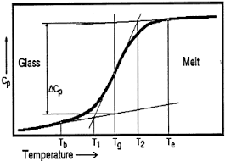
T_{G} vs. Phase transitions
Glass transition:
(different) discontinuity in 2nd deriv’s.
(Step not divergence)
First order PT
Discontinuity in (∂G/∂p)_{T} = V
Discontinuity in (∂G/∂T)_{p} = S
‘1st derivatives of G’
(Gibbs enthalpy)
Second order PT
Discontinuity in (∂V/∂T)_{p} = βV
Discontinuity in −(∂V/∂p)_{T} = κV
Discontinuity in (∂S/∂T)_{p} = c_{p}/T
‘2nd derivatives of G’
Heat capacitance vs. T for a polymer
going through T_{G}. Measured by ‘DSC’
Both 1st/2nd order PT: Equilibrium → (different) equilibrium
Glass transition: (non)- equilibrium → non- equilibrium: Not a PT
Notes:
dG = -SdT + Vdp for a reversible path

Slide 38
T_{G}: Thermodynamics
The glass transition is not a thermodynamic (phase) transition
It is a kinetic transition
T_{G} somewhat rate dependent
- But there’s a limit…
T_{g2}
Volume or Entropy
T_{g1}
T_{m}
Volume expansivity changes discontinuously: cooling rate for T_{g1} is less than that for T_{g2}
Temperature
S calculated by integrating heat capacity c_{p}
c_{p} = T(∂S/∂T)_{p}

Slide 39
Entropy and T_{G}: Kauzmann paradox
Extrapolate supercooled liquid （外推过冷液体）S(T)
below T_{M} to T_{K}:
S(liq) would drop below S(Xtal)
Paradox !?
T_{K}: Kauzmann temperature
From extrapolation: T_{K} ≈ T_{g} – 50K
T_{g2}
Entropy
T_{g1}
T_{m}
T_{K}
Temperature
➔ Note: T_{K} ≈ T_{VF}, where τ, η → ∞
Paradox avoided thanks to τ → ∞: Even ‘infinitesimally’ slow cooling cannot keep S(T) on ‘supercooled liquid’ line.
Glass below T_{VF} = permanent non- equilibrium. Usual thermodynamics suspended
➔ No (thermodynamic) Maxwell relations, no Clausius Clapeyron, no eutectic for T_{G} in blends. Also, S > 0 for T → 0 ←→ 3rd law

Slide 40
Summary: Lecture #4 The Glass transition
Complex fluid: Vogel Fulcher η(T) due to cooperativity
Steeper rise of η as T drops, often reaches τ = 10s before crystallising: Glass transition
VF η → WLF: ‘Time- temperature- superposition’
τ → ∞ at T_{VF} ≈ T_{G} - 50K. Near- universal constants C₁, C₂
Glass mechanics: Non- crystalline solid
- Glass thermodynamics: Equilibrium → non- equilibrium
not a phase transition
Kauzmann ‘paradox’ at T_{K} ≈ T_{G} – 50K
but τ → ∞ avoids paradox
For a given material, T_{K} ≈ T_{VF} ≈ T_{G} - 50K
Something interesting is going on
The material contained within lecture 4 is covered in SCM chapter 2.4

